Slide 1
Research Updates on GNN Species Discovery
Monte Carlo Tree Search:
From AlphaGo to Species Discovery
Boyuan Yu, Rui Xu
University of Southern California
July 22, 2026

Slide 2
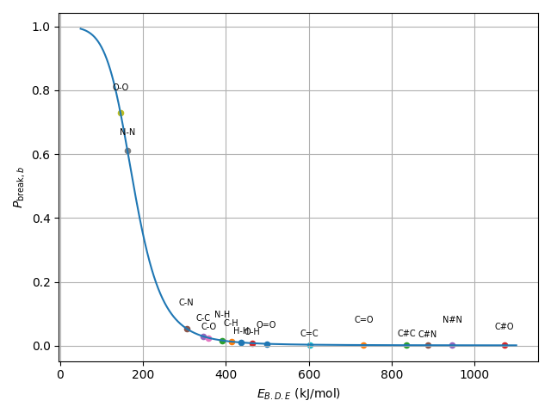
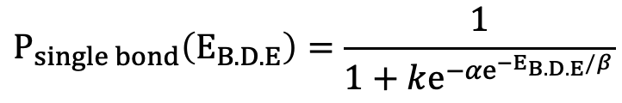
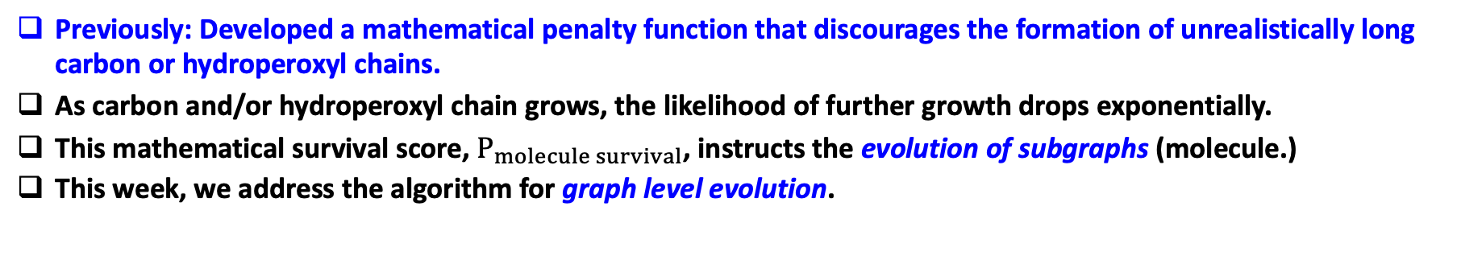
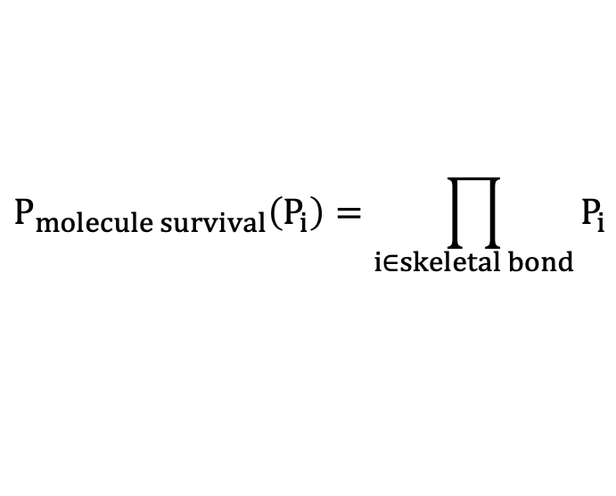
Previously Addressed Problems
Previously: Developed a mathematical penalty function that discourages the formation of unrealistically long carbon or hydroperoxyl chains.
As carbon and/or hydroperoxyl chain grows, the likelihood of further growth drops exponentially.
This mathematical survival score, $P_{molecule survival}$, instructs the evolution of subgraphs (molecule.)
This week, we address the algorithm for graph level evolution.
The probability for O-O bond breaking is much higher.
$$P_{single bond}\left(E_{B.D.E}\right)=\frac{1}{1+ke^{−{αe}^{−E_{B.D.E}/β}}}$$
Lower bond breaking probability compared with skeletal bonds
$$P_{molecule survival}\left(P_{i}\right)=\prod_{i∈skeletal bond}{P_{i}}$$
Very unlike to break but are constrained by valence rule.

Slide 3
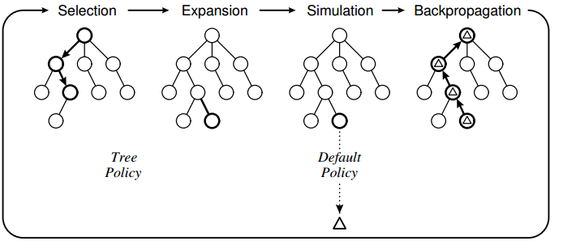
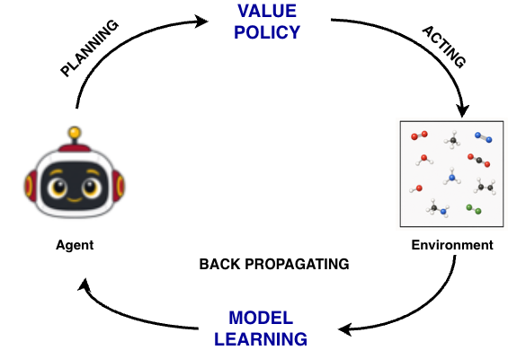

New Challenge: Define a Searching Problem
From graph, we may yield node (atom), edge (bond), and subgraph (molecule) information.
In a graph, we may take actions such as forming new bonds, destructing existing bonds increasing bond order, or decreasing bond order.
From a graph level, each bond action directs the graph to a new state.
Question: How do we choose action to direct the search?
Attempt: Implementing Monte Carlo Tree Search (MCTS), and implementing neural network for policy and state value estimation.
We implement MCTS and Neural Network Agent to a system containing C, O, H, and the searching aims to find its way to C-O-H state.

Slide 4
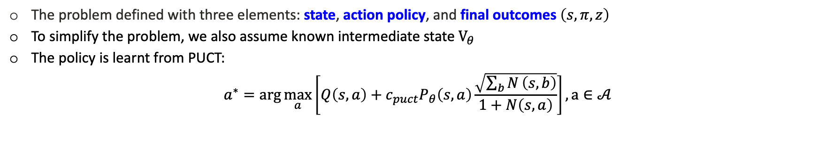
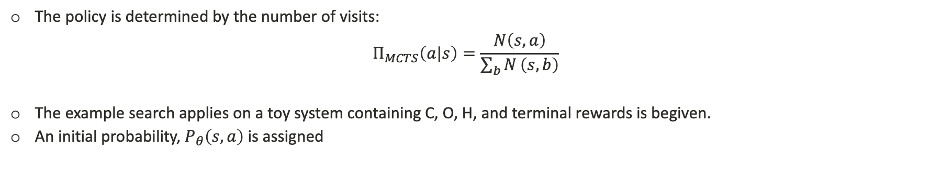
Attempt I: Monte Carlo Tree Search
The problem defined with three elements: state, action policy, and final outcomes $\left(s,π,z\right)$
To simplify the problem, we also assume known intermediate state $V_{θ}$
The policy is learnt from PUCT:
$$a^{∗}=\arg{\max_{a}\left[Q\left(s,a\right)+c_{puct}P_{θ}\left(s,a\right)\frac{\sqrt{\sum_{b}{N}\left(s,b\right)}}{1+N\left(s,a\right)}\right]}, a∈𝒜$$
exploitation, Q
exploration, U
The policy is determined by the number of visits:
$$Π_{MCTS}\left(a|s\right)=\frac{N\left(s,a\right)}{\sum_{b}{N}\left(s,b\right)}$$
The example search applies on a toy system containing C, O, H, and terminal rewards is begiven.
An initial probability, $P_{θ}\left(s,a\right)$ is assigned

Slide 5








Attempt I: Monte Carlo Tree Search Initialization
C, O, H
Form C-O
$$p = 0.45$$
Form O-H
$$p = 0.30$$
Form C-H
$$p = 0.20$$
STOP
$$p = 0.05$$
C-O, H
C, O-H
C-H, O
Terminal
C, H, O Terminal
V = 0.7
V = 0.6
R = 0.6
R = 0
STOP
$$p = 0.15$$
Form O-H
$$p = 0.85$$
Form C-O
$$p = 0.80$$
STOP
$$p = 0.20$$
C-O, H
Terminal
C-O-H
Terminal
C, O-H
Terminal
R = 0.7
R = 1
R = 0.6
V: Model Estimate
R: Terminal Reward
Initial free capacities: C:1, O:2, H:1 (Only for this simplified example)

Slide 6
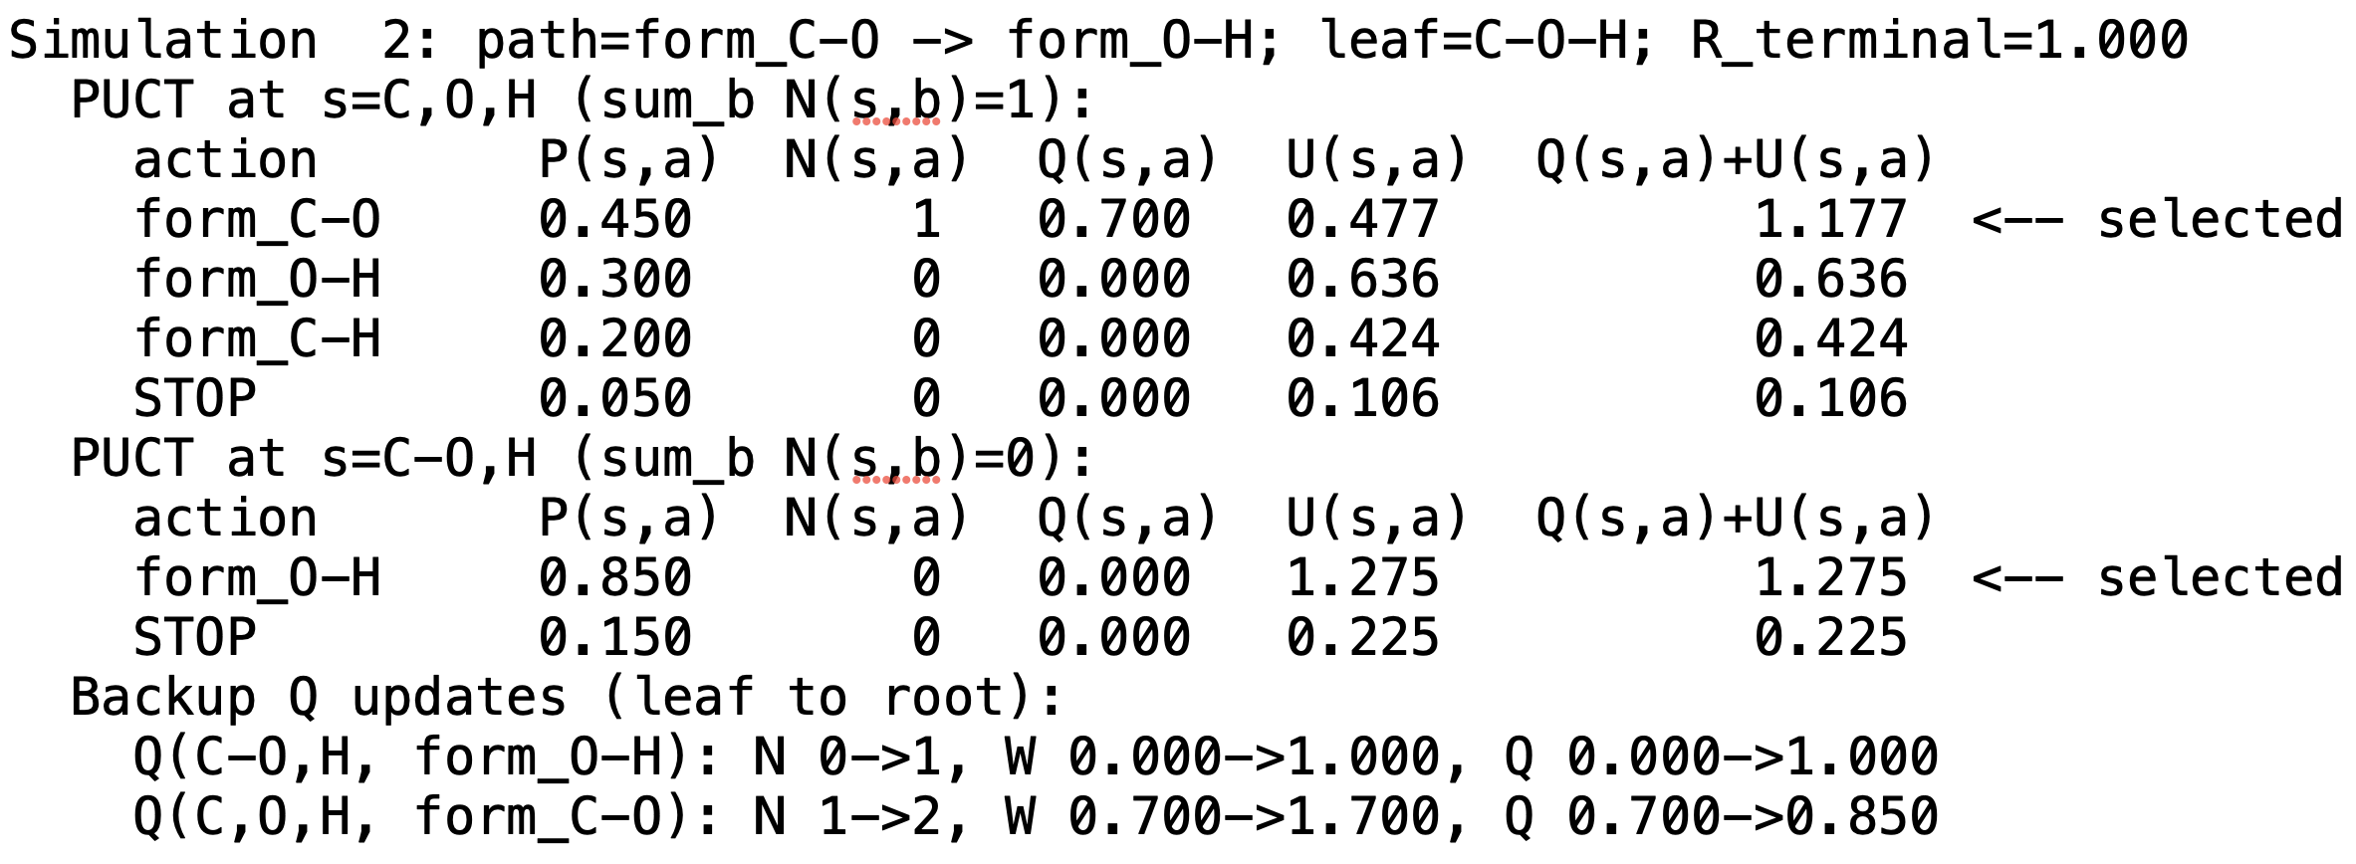
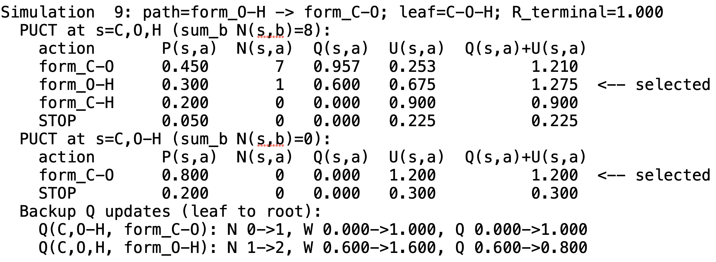
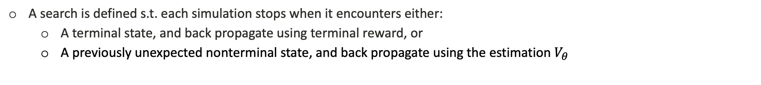
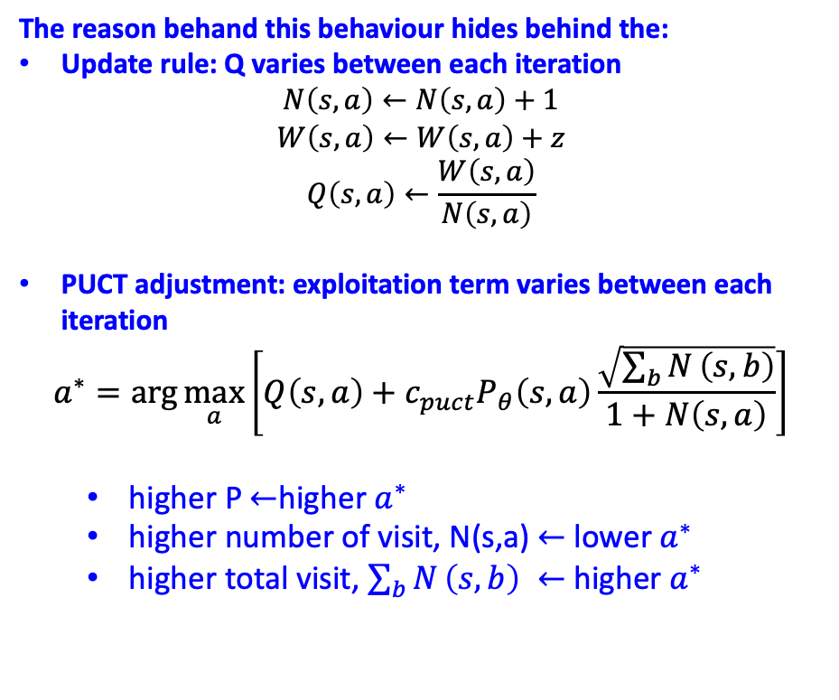
Attempt I: Searching Process
A search is defined s.t. each simulation stops when it encounters either:
A terminal state, and back propagate using terminal reward, or
A previously unexpected nonterminal state, and back propagate using the estimation $V_{θ}$
The reason behand this behaviour hides behind the:
Update rule: Q varies between each iteration
$$N\left(s,a\right)←N\left(s,a\right)+1$$
$$W\left(s,a\right)←W\left(s,a\right)+z$$
$$Q\left(s,a\right)←\frac{W\left(s,a\right)}{N\left(s,a\right)}$$
PUCT adjustment: exploitation term varies between each iteration
$$a^{∗}=\arg{\max_{a}\left[Q\left(s,a\right)+c_{puct}P_{θ}\left(s,a\right)\frac{\sqrt{\sum_{b}{N}\left(s,b\right)}}{1+N\left(s,a\right)}\right]}$$
higher P $←$higher $a^{∗}$
higher number of visit, N(s,a) $←$ lower $a^{∗}$
higher total visit, $\sum_{b}{N}\left(s,b\right) ←$ higher $a^{∗}$
Actions in sim2
Actions in sim9

Slide 7











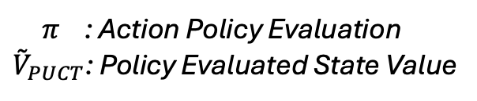
Attempt I: Searching Update
C, O, H
$${\overset{˜}{V}}_{PUCT}=0.945$$
Form C-O
$$π=0.60$$
Form O-H
$$π=0.34$$
Form C-H
$$π=0.06$$
STOP
$$π=0.00$$
C-O, H
C, O-H
C-H, O
Terminal
C, H, O Terminal
$${\overset{˜}{V}}_{PUCT}=0.981$$
$${\overset{˜}{V}}_{PUCT}=0.969$$
R = 0.6
R = 0
STOP
$$π=0.06$$
Form O-H
$$π=0.94$$
Form C-O
$$π=0.92$$
STOP
$$π=0.08$$
C-O, H
Terminal
C-O-H
Terminal
C, O-H
Terminal
$π$ : Action Policy Evaluation
${\overset{˜}{V}}_{PUCT}$: Policy Evaluated State Value
R = 0.7
R = 1
R = 0.6

Slide 8
Attempt II: Monte Carlo Tree Search with Neural Network Agent
There are two problems inherent from Monte Carlo Tree Search:
Intermediate state value estimation: The previous example assign fixed intermediate value. This assignment may not be accurate, or even possible for a complex system
Lack of nonlinear decision-making: The current PUCT evaluation lacks nonlinearity for action policy.
Solution: Neural Network Agent for policy making

Slide 9
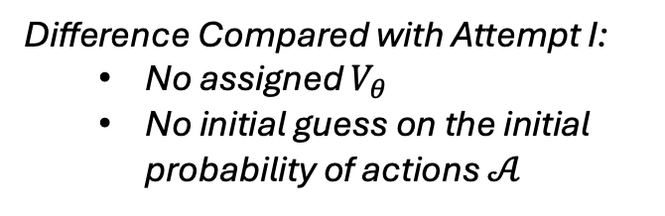
Attempt II: MCTS + Neural Network Agent Initialization
C, O, H
Form C-O
Form O-H
Form C-H
STOP
C-O, H
C, O-H
C-H, O
Terminal
C, H, O Terminal
R = 0.6
R = 0
STOP
Form O-H
Form C-O
STOP
C-O, H
Terminal
C-O-H
Terminal
C, O-H
Terminal
Difference Compared with Attempt I:
No assigned $V_{θ}$
No initial guess on the initial probability of actions $𝒜$
R = 0.7
R = 1
R = 0.6

Slide 10
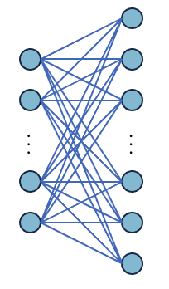

Attempt II: Searching Process
Starting from random rollout, then introducing neural network guided exploration
The initial probabilities are evaluated from random rollout
The neural network is trained and later implemented into the exploration procedure
Masking for valid action
Score of each action
. . .
$$V_{θ}$$
Shared Layer

Slide 11
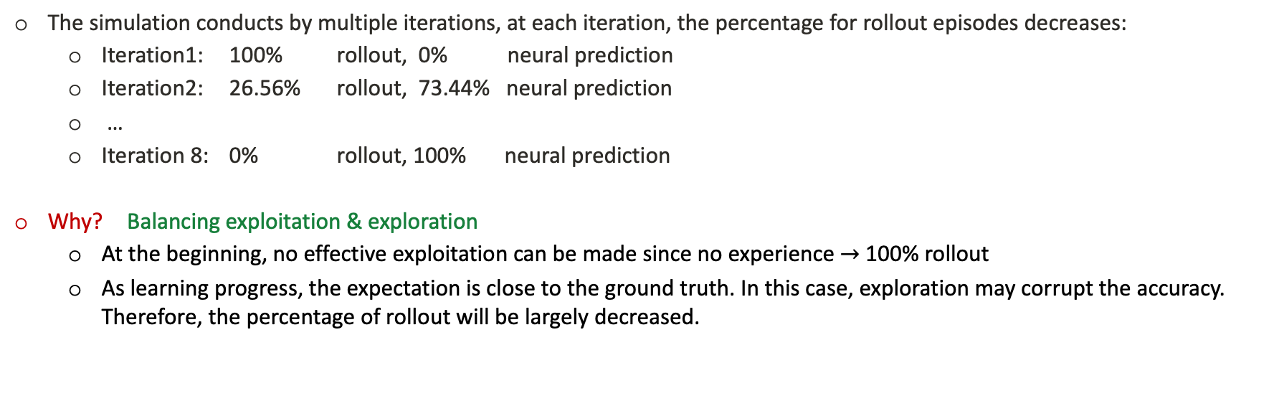
Attempt II: Searching Iterations
The simulation conducts by multiple iterations, at each iteration, the percentage for rollout episodes decreases:
Iteration1: 100% rollout, 0% neural prediction
Iteration2: 26.56% rollout, 73.44% neural prediction
…
Iteration 8: 0% rollout, 100% neural prediction
Why? Balancing exploitation & exploration
At the beginning, no effective exploitation can be made since no experience $→$ 100% rollout
As learning progress, the expectation is close to the ground truth. In this case, exploration may corrupt the accuracy. Therefore, the percentage of rollout will be largely decreased.

Slide 12











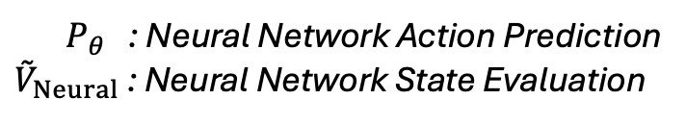
Attempt II: Searching Results
C, O, H
$${\overset{˜}{V}}_{Neural}=0.949$$
Form C-O
$$P_{θ}=0.482$$
Form O-H
$$P_{θ}=0.473$$
Form C-H
$$P_{θ}=0.034$$
STOP
$$P_{θ}=0.011$$
C-O, H
C, O-H
C-H, O
Terminal
C, H, O Terminal
$${\overset{˜}{V}}_{Neural}=0.969$$
$${\overset{˜}{V}}_{Neural}=0.970$$
R = 0.6
R = 0
STOP
$$P_{θ}=0.091$$
Form O-H
$$P_{θ}=0.909$$
Form C-O
$$P_{θ}=0.932$$
STOP
$$P_{θ}=0.068$$
C-O, H
Terminal
C-O-H
Terminal
C, O-H
Terminal
$P_{θ}$ : Neural Network Action Prediction
${\overset{˜}{V}}_{Neural}$ : Neural Network State Evaluation
R = 0.7
R = 1
R = 0.6

Slide 13
Achievement and Further Implementation
Achieved: The neural network agent, together with PUCT, is capable to predict the value of intermediate state guide the state evaluation.
For more complex system: graph isomorphism
Two bond graph, despite different adjacent matrix, may represent identical state. We will develop a function to identify the identical state and consider graph transposition.
Open Question: Design Reward and the depth of exploration, and what species should be extracted
For a complex system, reward rule is needed for recognizing different state that it reached. Meanwhile, as the tree depth grows, rewarding intermediate state may speed up the iteration.
Fix-depth exploration and/or rule guided exploration?
Should we read species along the tree branch? Or should we only explore species from the end state?

